Slide 1
Crypt-Enum
Pratish Bhansali, Lokesh Mishra, Rohan Karki, K. Sri Dhanush Reddy
Schaefer School of Engineering & Science
MS in Cybersecurity
CPE 579 - Foundations of Cryptography

Slide 2
ABSTRACT
We developed a tool to perform multiple tasks like encryption, decryption, steganography and enumerations which are basically used in a Linux environment machine.
These tasks help in the primary stages of penetration testing and the decrypting operation is very useful to decrypt any found passwords or hashes.
Encryption is used to encrypt plain text and inserted it into the found sensitive files to perform our desired actions.
Steganography is a technique to encode messages into an image to hide any information in plain sight undetected and also water-marking our content.
Enumeration is used for footprinting/fingerprinting by finding sub-domains and hidden sub-directories of a given list of domains.
Port scanning is very useful to find any vulnerable network or server for penetration attacks.
All these tasks can be run from our tool so the user can perform these tasks with ease.

Slide 3
Tools and Dependencies Used
Virtualization: Oracle VirtualBox
OS: Kali Linux 2021.3
Programming: Python and Bash
Tools Used: Nmap, subfinder, assetfinder, shuffledns, GoBuster

Slide 4
Operations in Detail
Encryption Operation
Encryption to Base64, SHA-256, MD5 and ROT13
Base64:
Base64 is a binary-to-text encoding technique that converts binary data into an ASCII string. Base64 is designed to transport binary data across several channels. It converts any type of information into a long string of plain text.
SHA-256:
Are a set of cryptographic hash functions designed by the United States National Security Agency (NSA).
SHA-256 is a novel hash function computed with eight 32-bit.

Slide 5
Operations in Detail
Encryption Operation
MD5:
The MD5 hashing algorithm is a one-way cryptographic function that receives any length message as input and returns a fixed-length digest value that may be used to authenticate the original message.
The MD5 hash function was created to be a secure cryptographic hash method for digital signature authentication.
ROT13:
It is a straightforward letter substitution cipher that substitutes a letter with the alphabet's 13th letter. The ROT13 encryption is a variant of the Caesar cipher, which was created in ancient Rome.

Slide 6


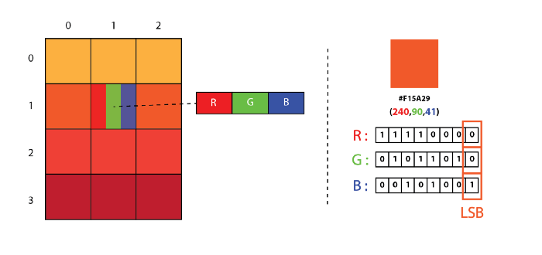
Operations in Detail
Steganography Operation
It is the technique of concealing a secret message within (or even on top of) a non-secret object. That something can be anything you want it to be. The purpose of steganography is to conceal and deceive.
Two techniques of image steganography are discussed here:
LSB Steganography is an image steganography technique in which messages are hidden inside an image by replacing each pixel’s least significant bit with the bits of the message to be hidden.
→
Encode

Slide 7
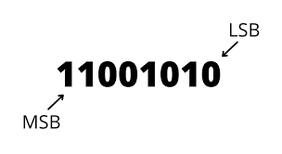

Operations in Detail
Staganography Operation
MSB Steganography is an image steganography technique in which messages are hidden inside an image by replacing each pixel’s most significant bit with the bits of the message to be hidden.
→
Encode

Slide 8
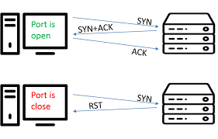
Operations in Detail
Enumeration Operation
Port Scanning:
A port scan is a method of detecting open doors or weak points in a network. A port scan attack locates open ports and determines whether they are receiving or transmitting data. It can also tell whether a business uses active security equipment such as firewalls.

Slide 9
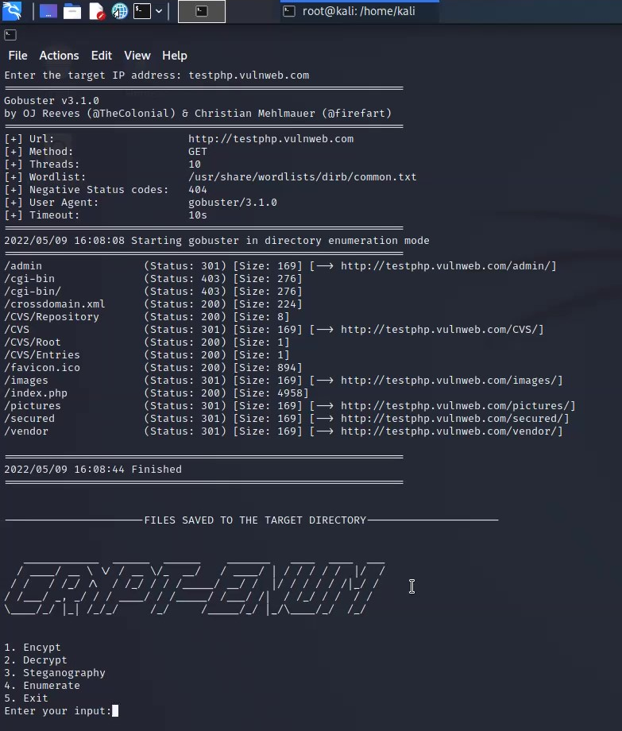
Operations in Detail
Enumeration Operation
Directory Brute forcing:
To try to breach a site, directory brute force is used to uncover hidden and frequently forgotten directories. The state of the directory is brute-forced using custom wordlists using a variety of automated tools and scripts.

Slide 10
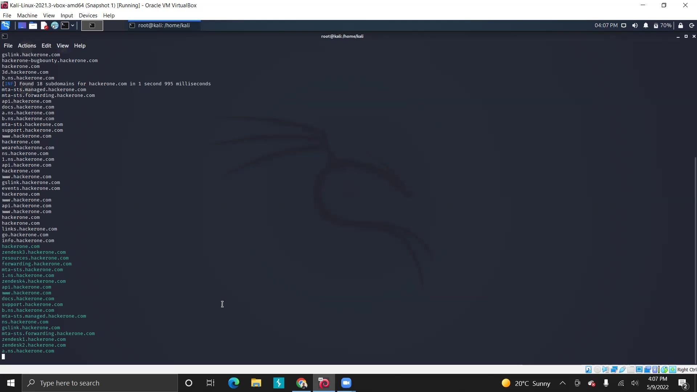
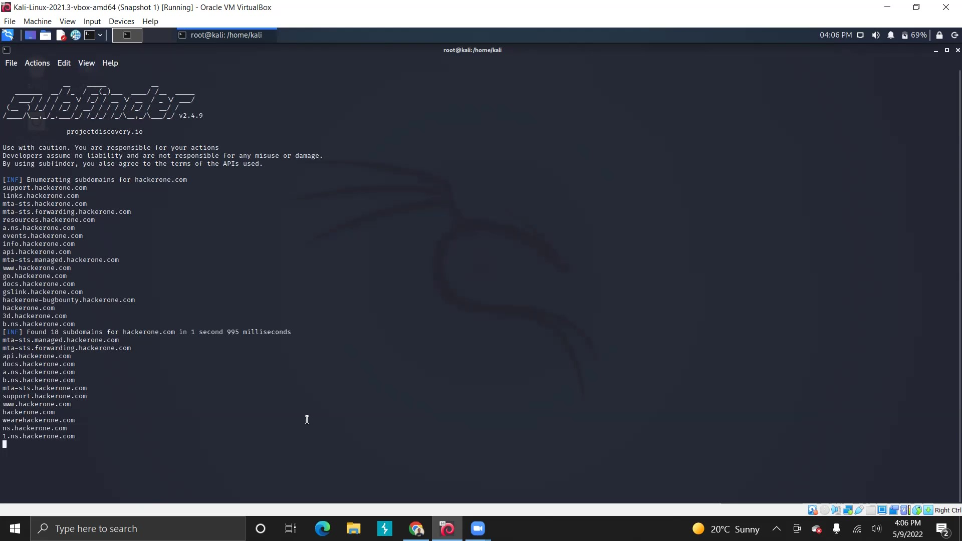
Operations in Detail
Enumeration Operation
Sub-domain Enumeration:
The process of enumerating valid (resolvable) subdomains for one or more domains is known as subdomain enumeration. It's difficult to get a list of existing subdomains unless the DNS server publishes a whole DNS zone (through AFXR). A frequent approach is to look up common names in a dictionary and try to resolve them.
Live domains are also filtered and shown in this operation.

Slide 11
Conclusion and Future Scope
We successfully developed a tool that performs various enumeration tasks with ease.
This tool consumes little RAM, hence the execution time is less.
This tool could be upgraded with more encryption standard options.
Also adding an option for a vulnerability scanner would be a great addition to the tool.
A rate of flexibility can be observed as more applications can be added to increase its functionality.

Slide 12

Demo

Slide 13
Thank You

